Slide 1

Lecture 2-Algorithm Analysis
Bushra Fazal(Assistant Professor)
Department of Software Engineering
Bahria University Karachi Campus

Slide 2
Algorithm
An algorithm is a set of instructions to be followed to solve a problem.
  There can be more than one solution (more than one algorithm) to solve a given problem.
  An algorithm can be implemented using different programming languages on different platforms.
An algorithm must be correct. It should correctly solve the problem.
  e.g. For sorting, this means even if (1) the input is already sorted, or (2) it contains repeated elements.
Once we have a correct algorithm for a problem, we have to determine the efficiency of that algorithm.

Slide 3
Algorithmic Performance
There are two aspects of algorithmic performance:
Time
    Instructions take time.
    How fast does the algorithm perform?
    What affects its runtime?
Space
    Data structures take space
    What kind of data structures can be used?
    How does choice of data structure affect the runtime?
We will focus on time:
  How to estimate the time required for an algorithm
  How to reduce the time required

Slide 4
Analysis of Algorithms
Analysis of Algorithms is the area of computer science that provides tools to analyze the efficiency of different methods of solutions.
How do we compare the time efficiency of two algorithms that solve the same problem?
Naïve Approach: implement these algorithms in a programming language (C++), and run them to compare their time requirements. Comparing the programs (instead of algorithms) has difficulties.
  How are the algorithms coded?
    Comparing running times means comparing the implementations.
    We should not compare implementations, because they are sensitive to programming style that may cloud the issue of which algorithm is inherently more efficient.
  What computer should we use?
    We should compare the efficiency of the algorithms independently of a particular computer.
  What data should the program use?
    Any analysis must be independent of specific data.

Slide 5
Analysis of Algorithms
When we analyze algorithms, we should employ mathematical techniques that analyze algorithms independently of specific implementations, computers, or data.
To analyze algorithms:
  First, we start to count the number of significant operations in a particular solution to assess its efficiency.
  Then, we will express the efficiency of algorithms using growth functions.

Slide 6
The Execution Time of Algorithms
Each operation in an algorithm (or a program) has a cost.
➔ Each operation takes a certain of time.
count = count + 1; ➔ take a certain amount of time, but it is constant
A sequence of operations:
count = count + 1; Cost: c₁
sum = sum + count; Cost: c₂
➔ Total Cost = c₁ + c₂

Slide 7
The Execution Time of Algorithms (cont.)
Example: Simple If-Statement
Cost Times
if (n < 0) c1 1
absval = -n c2 1
else
absval = n; c3 1
Total Cost <= c1 + max(c2,c3)

Slide 8
The Execution Time of Algorithms (cont.)
Example: Simple Loop
Cost Times
i = 1; c1 1
sum = 0; c2 1
while (i <= n) { c3 n+1
i = i + 1; c4 n
sum = sum + i; c5 n
}
Total Cost = c1 + c2 + (n+1)*c3 + n*c4 + n*c5
➔ The time required for this algorithm is proportional to n

Slide 9
The Execution Time of Algorithms (cont.)
Example: Nested Loop
Cost Times
i=1; c1 1
sum = 0; c2 1
while (i <= n) { c3 n+1
j=1; c4 n
while (j <= n) { c5 n*(n+1)
sum = sum + i; c6 n*n
j = j + 1; c7 n*n
}
i = i +1; c8 n
}
Total Cost = c1 + c2 + (n+1)*c3 + n*c4 + n*(n+1)*c5+n*n*c6+n*n*c7+n*c8
➔ The time required for this algorithm is proportional to n²

Slide 10
General Rules for Estimation
Loops: The running time of a loop is at most the running time of the statements inside of that loop times the number of iterations.
Nested Loops: Running time of a nested loop containing a statement in the inner most loop is the running time of statement multiplied by the product of the sized of all loops.
Consecutive Statements: Just add the running times of those consecutive statements.
If/Else: Never more than the running time of the test plus the larger of running times of S1 and S2.

Slide 11
Algorithm Growth Rates
We measure an algorithm’s time requirement as a function of the problem size.
  Problem size depends on the application: e.g. number of elements in a list for a sorting algorithm, the number disks for towers of hanoi.
So, for instance, we say that (if the problem size is n)
  Algorithm A requires 5*n² time units to solve a problem of size n.
  Algorithm B requires 7*n time units to solve a problem of size n.
The most important thing to learn is how quickly the algorithm’s time requirement grows as a function of the problem size.
  Algorithm A requires time proportional to n².
  Algorithm B requires time proportional to n.
An algorithm’s proportional time requirement is known as growth rate.
We can compare the efficiency of two algorithms by comparing their growth rates.

Slide 12
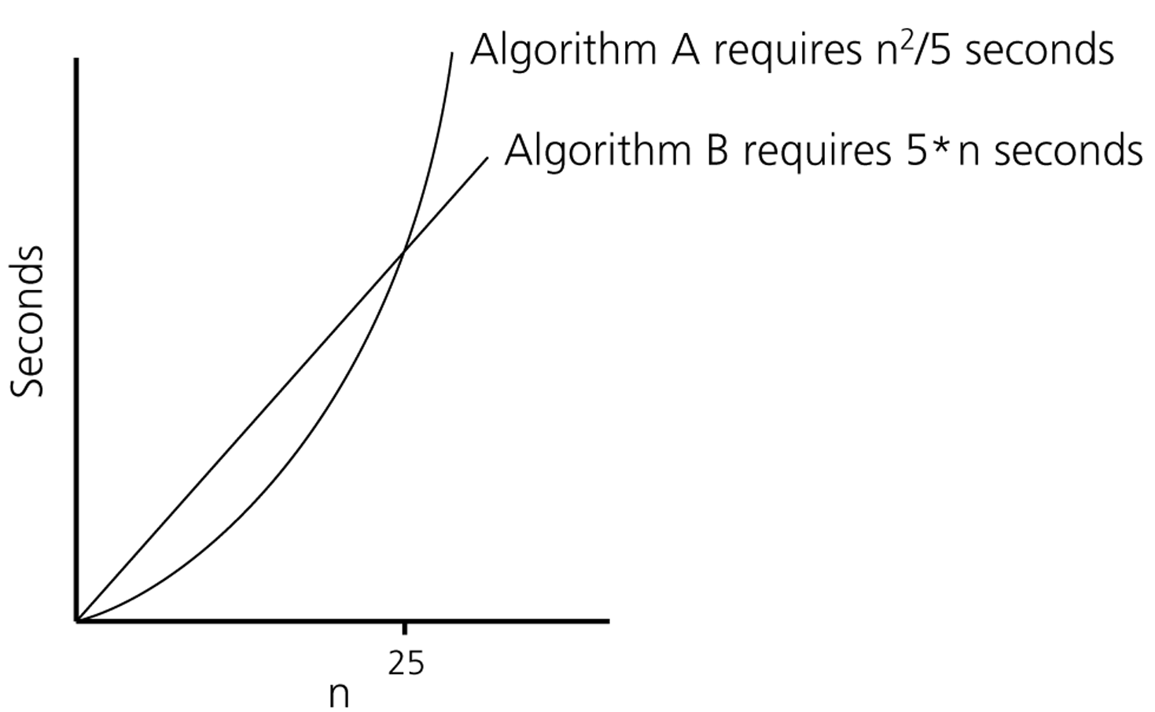
Algorithm Growth Rates (cont.)
Time requirements as a function
of the problem size n

Slide 13
Common Growth Rates
Function | Growth Rate Name
c | Constant
log N | Logarithmic
log²N | Log-squared
N | Linear
N log N
N² | Quadratic
N³ | Cubic
2^{N} | Exponential

Slide 14

Figure 6.1
Running times for small inputs

Slide 15

Figure 6.2
Running times for moderate inputs

Slide 16
Asymptotic Notation
O notation :Big-O is the formal method of expressing the upper bound of an algorithm's running time.
It's a measure of the longest amount of time it could possibly take for the algorithm to complete.
Formally, for non-negative functions, f(n) and g(n), if there exists an integer n₀ and a constant c > 0 such that for all integers n > n₀, f(n) ≤ cg(n), then f(n) is Big O of g(n).

Slide 17
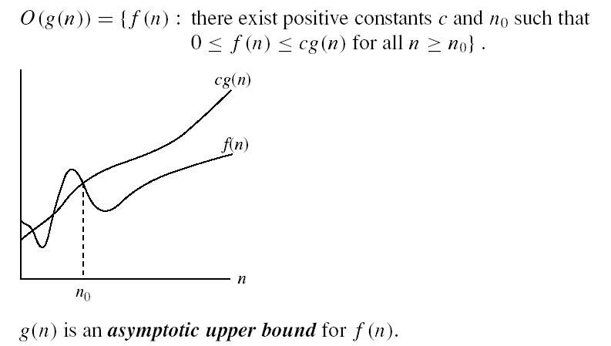
Asymptotic notations
O-notation

Slide 18
Asymptotic Notation
Big-Omega Notation Ω
This is almost the same definition as Big Oh, except that "f(n) ≥ cg(n)”
This makes g(n) a lower bound function, instead of an upper bound function.
It describes the best that can happen for a given data size.
For non-negative functions, f(n) and g(n), if there exists an integer n₀ and a constant c > 0 such that for all integers n > n₀, f(n) ≥ cg(n), then f(n) is omega of g(n). This is denoted as "f(n) = Ω(g(n))".

Slide 19
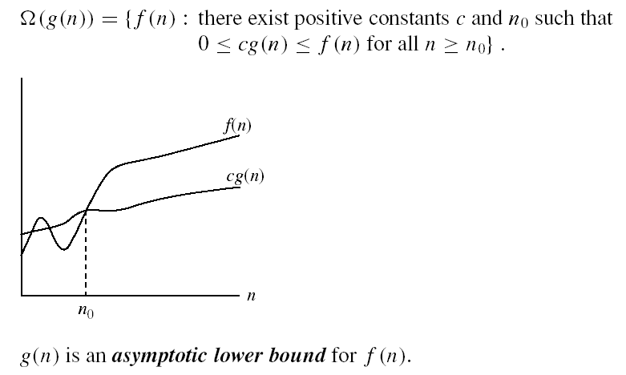
Asymptotic notations (cont.)
Ω - notation
Ω(g(n)) is the set of functions with larger or same order of growth as g(n)

Slide 20
Asymptotic Notation
Theta Notation Θ
Theta Notation For non-negative functions, f(n) and g(n), f(n) is theta of g(n) if and only if f(n) = O(g(n)) and f(n) = Ω(g(n)). This is denoted as "f(n) = Θ(g(n))".
This is basically saying that the function, f(n) is bounded both from the top and bottom by the same function, g(n).

Slide 21


Asymptotic notations (cont.)
Θ-notation
Θ(g(n)) is the set of functions with the same order of growth as g(n)

Slide 22
Order-of-Magnitude Analysis and Big O Notation
If Algorithm A requires time proportional to f(n), Algorithm A is said to be order f(n), and it is denoted as O(f(n)).
The function f(n) is called the algorithm’s growth-rate function.
Since the capital O is used in the notation, this notation is called the Big O notation.
If Algorithm A requires time proportional to n², it is O(n²).
If Algorithm A requires time proportional to n, it is O(n).

Slide 23
Definition of the Order of an Algorithm
Definition:
Algorithm A is order f(n) – denoted as O(f(n)) –
if constants k and n₀ exist such that A requires
no more than k*f(n) time units to solve a problem
of size n ≥ n₀.
The requirement of n ≥ n₀ in the definition of O(f(n)) formalizes the notion of sufficiently large problems.
  In general, many values of k and n can satisfy this definition.

Slide 24
Order of an Algorithm
If an algorithm requires n²–3*n+10 seconds to solve a problem size n. If constants k and n₀ exist such that
k*n² > n²–3*n+10 for all n ≥ n₀ .
the algorithm is order n² (In fact, k is 3 and n₀ is 2)
3*n² > n²–3*n+10 for all n ≥ 2 .
Thus, the algorithm requires no more than k*n² time units for n ≥ n₀ ,
So it is O(n²)

Slide 25
Growth-Rate Functions
O(1) Time requirement is constant, and it is independent of the problem’s size.
O(log₂n) Time requirement for a logarithmic algorithm increases increases slowly
as the problem size increases.
O(n) Time requirement for a linear algorithm increases directly with the size
of the problem.
O(n*log₂n) Time requirement for a n*log₂n algorithm increases more rapidly than
a linear algorithm.
O(n²) Time requirement for a quadratic algorithm increases rapidly with the
size of the problem.
O(n³) Time requirement for a cubic algorithm increases more rapidly with the
size of the problem than the time requirement for a quadratic algorithm.
O(2^{n}) As the size of the problem increases, the time requirement for an
exponential algorithm increases too rapidly to be practical.

Slide 26
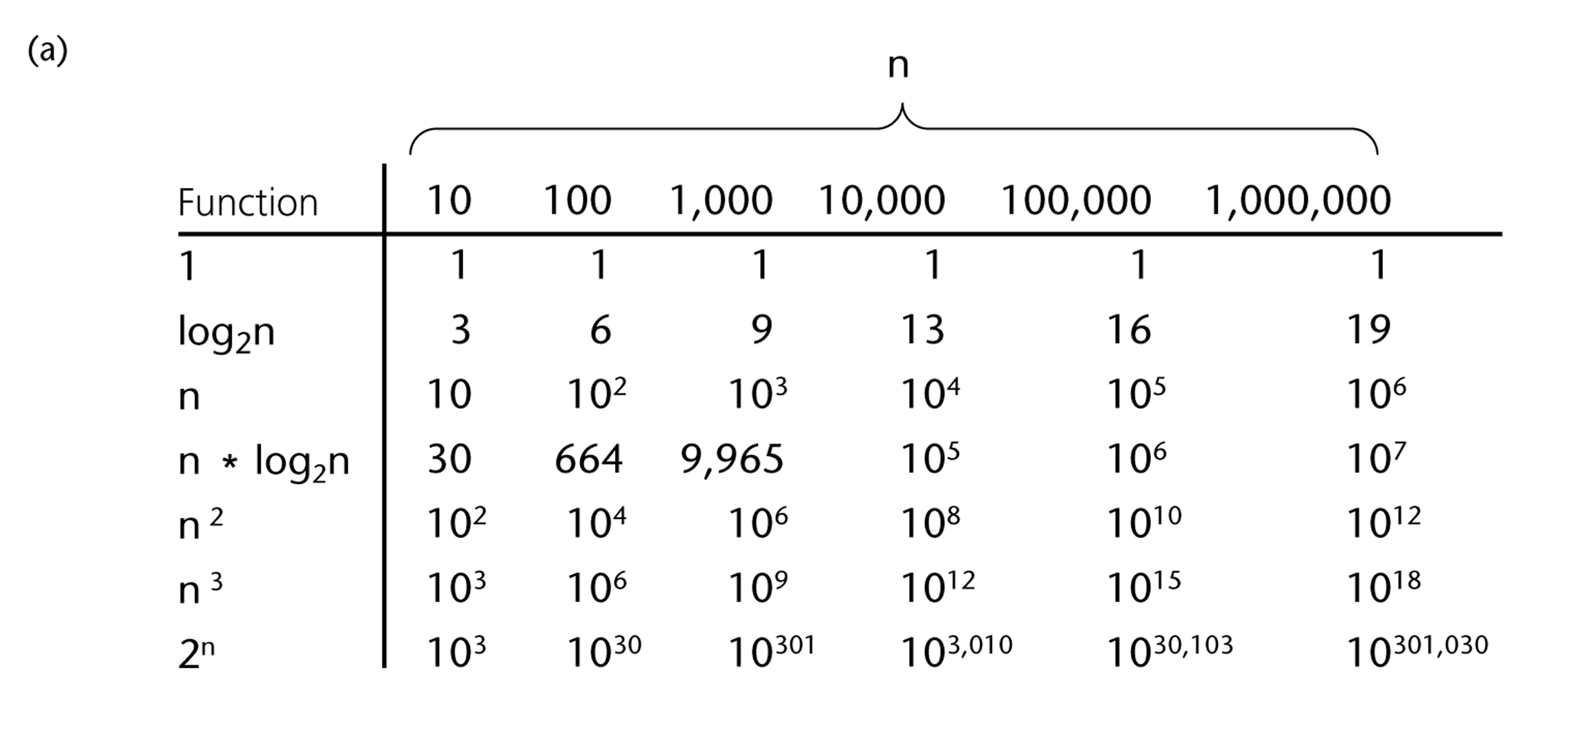
A Comparison of Growth-Rate Functions

Slide 27
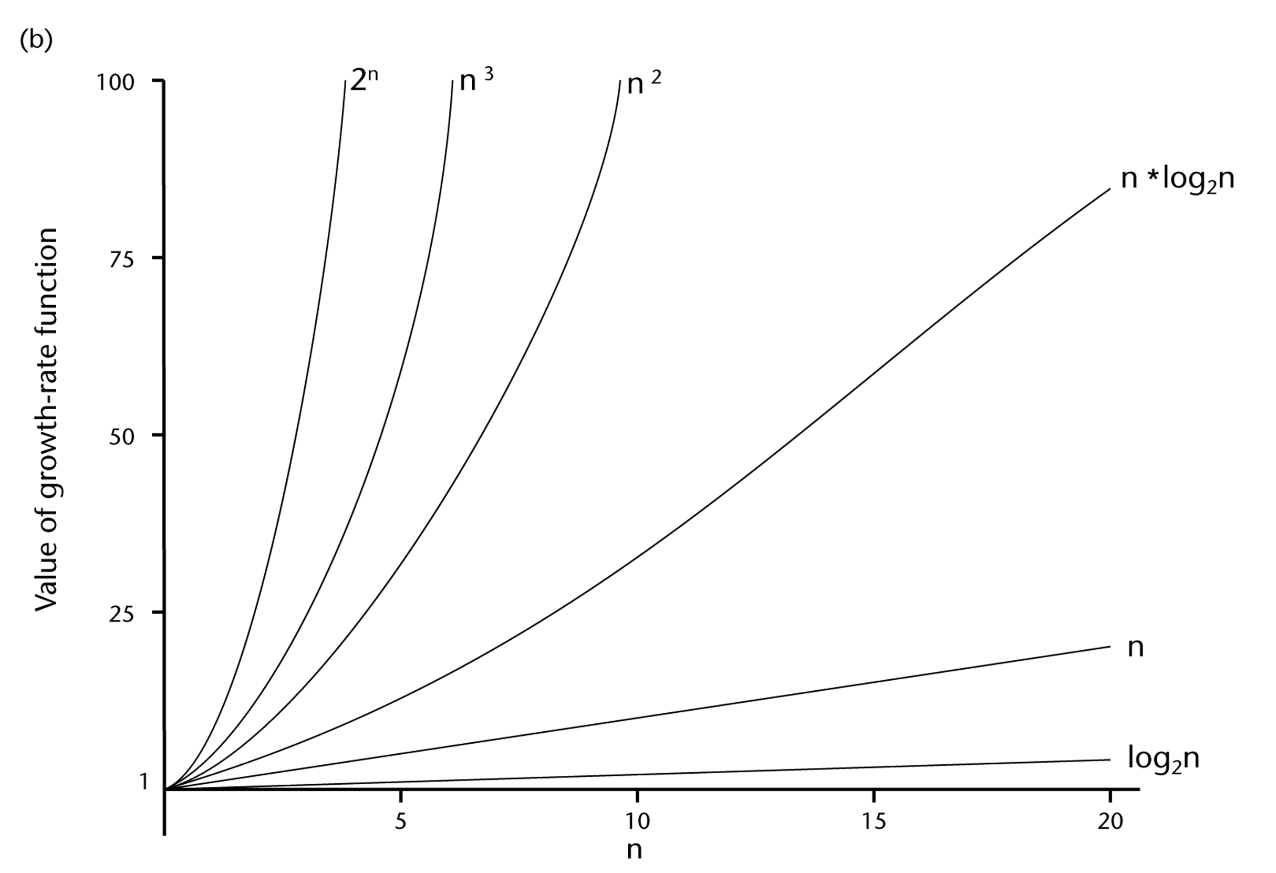
A Comparison of Growth-Rate Functions (cont.)

Slide 28
Growth-Rate Functions
If an algorithm takes 1 second to run with the problem size 8, what is the time requirement (approximately) for that algorithm with the problem size 16?
If its order is:
O(1) ➔ T(n) = 1 second
O(log₂n) ➔ T(n) = (1*log₂16) / log₂8 = 4/3 seconds
O(n) ➔ T(n) = (1*16) / 8 = 2 seconds
O(n*log₂n) ➔ T(n) = (1*16*log₂16) / 8*log₂8 = 8/3 seconds
O(n²) ➔ T(n) = (1*16²) / 8² = 4 seconds
O(n³) ➔ T(n) = (1*16³) / 8³ = 8 seconds
O(2^{n}) ➔ T(n) = (1*2¹⁶) / 2⁸ = 2⁸ seconds = 256 seconds

Slide 29
How much better is O(log₂n)?
n O(log₂n)
16 4
64 6
256 8
1024 (1KB) 10
16,384 14
131,072 17
262,144 18
524,288 19
1,048,576 (1MB) 20
1,073,741,824 (1GB) 30

Slide 30
Properties of Growth-Rate Functions
We can ignore low-order terms in an algorithm’s growth-rate function.
  If an algorithm is O(n³+4n²+3n), it is also O(n³).
  We only use the higher-order term as algorithm’s growth-rate function.
We can ignore a multiplicative constant in the higher-order term of an algorithm’s growth-rate function.
  If an algorithm is O(5n³), it is also O(n³).
O(f(n)) + O(g(n)) = O(f(n)+g(n))
  We can combine growth-rate functions.
  If an algorithm is O(n³) + O(4n), it is also O(n³ +4n²) ➔ So, it is O(n³).
  Similar rules hold for multiplication.

Slide 31
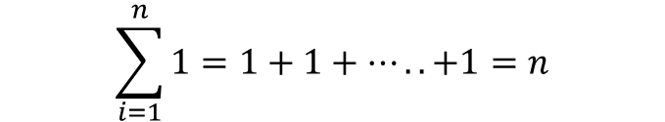
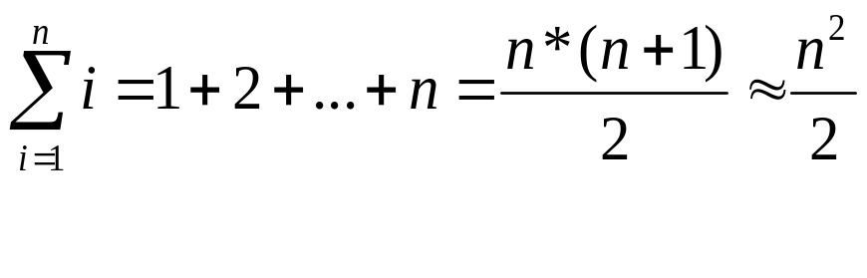
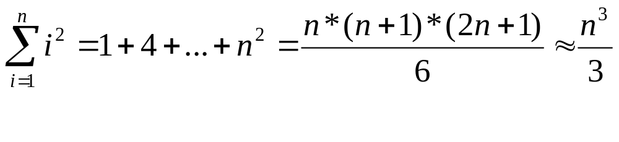
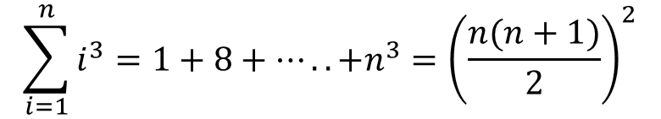
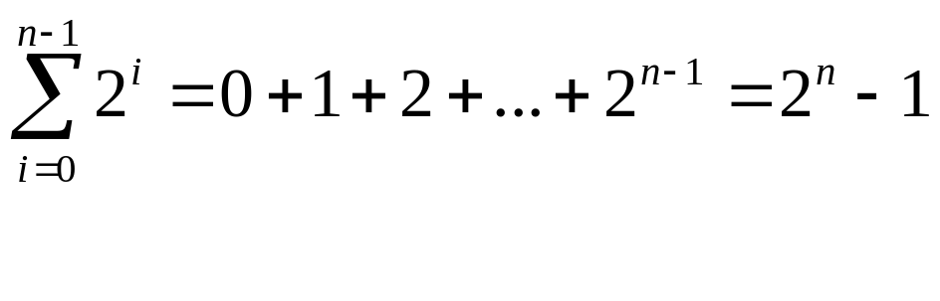
Some Mathematical Facts
Some mathematical equalities are:

Slide 32
Growth-Rate Functions – Example1
Cost Times
i = 1; c1 1
sum = 0; c2 1
while (i <= n) { c3 n+1
i = i + 1; c4 n
sum = sum + i; c5 n
}
T(n) = c1 + c2 + (n+1)*c3 + n*c4 + n*c5
= (c3+c4+c5)*n + (c1+c2+c3)
= a*n + b
➔ So, the growth-rate function for this algorithm is O(n)

Slide 33
Growth-Rate Functions – Example2
Cost Times
i=1; c1 1
sum = 0; c2 1
while (i <= n) { c3 n+1
j=1; c4 n
while (j <= n) { c5 n*(n+1)
sum = sum + i; c6 n*n
j = j + 1; c7 n*n
}
i = i +1; c8 n
}
T(n) = c1 + c2 + (n+1)*c3 + n*c4 + n*(n+1)*c5+n*n*c6+n*n*c7+n*c8
= (c5+c6+c7)*n² + (c3+c4+c5+c8)*n + (c1+c2+c3)
= a*n² + b*n + c
➔ So, the growth-rate function for this algorithm is O(n²)

Slide 34
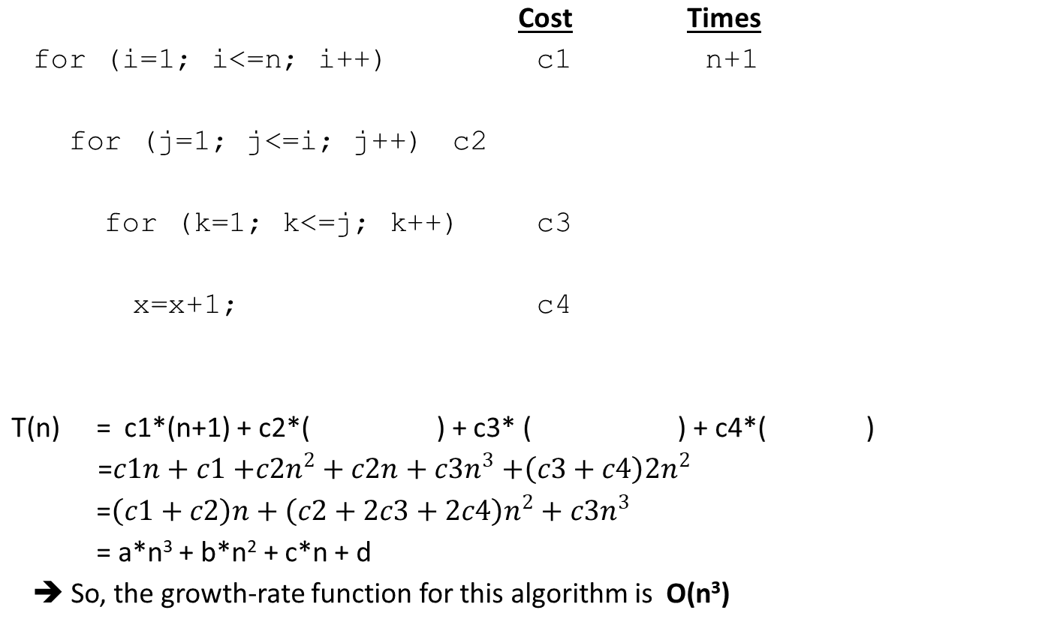
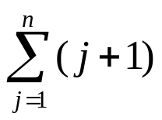
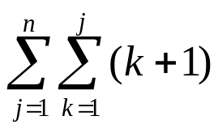
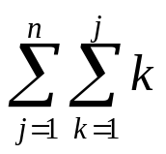
Growth-Rate Functions – Example3

Slide 35
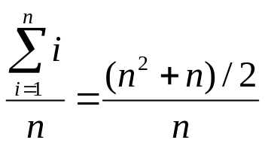
Sequential Search
int sequentialSearch(const int a[], int item, int n){
for (i = 0; i < n && a[i]!= item; i++);
if (i == n)
return –1;
return i;
}
Unsuccessful Search: ➔ O(n)
Successful Search:
Best-Case: item is in the first location of the array ➔O(1)
Worst-Case: item is in the last location of the array ➔O(n)
Average-Case: The number of key comparisons 1, 2, ..., n
➔ O(n)

Slide 36
Binary Search-Iterative
int binarySearch(int a[], int size, int x) {
int low =0;
int high = size –1;
int mid; // mid will be the index of
// target when it’s found.
while (low <= high) {
mid = (low + high)/2;
if (a[mid] == x)
return mid;
else if (a[mid] > x)
high = mid – 1;
else
low = mid + 1;
}
return –1;
}

Slide 37
Binary Search-Recursive
int binarySearch(int []a, int lo, int hi, int x)
{
int mid= (lo+hi)/2;
if(a[mid]==x) return mid;
else if(a[mid]>x)
return binarySearch(a,lo,mid-1);
else return binarySearch(a mid+1,hi);
}

Slide 38
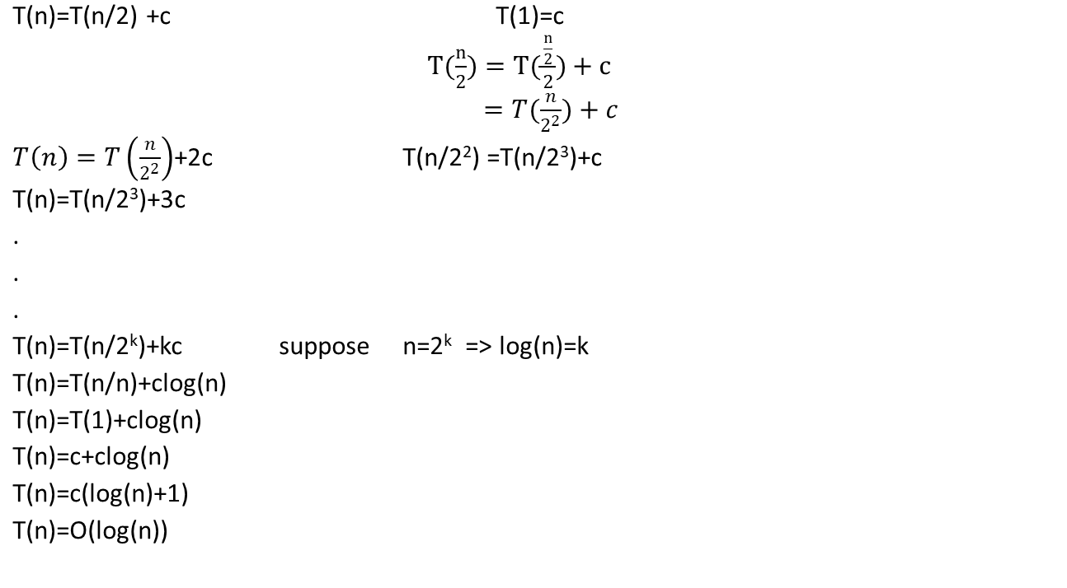
Binary Search – Analysis

Slide 39
Binary Search – Analysis
For an unsuccessful search:
  The number of iterations in the loop is ⎣log₂n⎦ + 1
  ➔ O(log₂n)
For a successful search:
  Best-Case: The number of iterations is 1. ➔ O(1)
  Worst-Case: The number of iterations is ⎣log₂n⎦ +1 ➔ O(log₂n)
  Average-Case: The avg. # of iterations < log₂n ➔ O(log₂n)
  0 1 2 3 4 5 6 7 ← an array with size 8
  3 2 3 1 3 2 3 4 ← # of iterations
  The average # of iterations = 21/8 < log₂8

Slide 40
Growth-Rate Functions – Recursive Algorithms
void hanoi(int n, char source, char dest, char spare) { Cost
if (n > 0) { c1
hanoi(n-1, source, spare, dest); c2
cout << "Move top disk from pole " << source c3
<< " to pole " << dest << endl;
hanoi(n-1, spare, dest, source); c4
} }
The time-complexity function T(n) of a recursive algorithm is defined in terms of itself, and this is known as recurrence equation for T(n).
To find the growth-rate function for a recursive algorithm, we have to solve its recurrence relation.

Slide 41
Growth-Rate Functions – Hanoi Towers
What is the cost of hanoi(n,’A’,’B’,’C’)?
when n=0
T(0) = c1
when n>0
T(n) = c1 + c2 + T(n-1) + c3 + c4 + T(n-1)
= 2*T(n-1) + (c1+c2+c3+c4)
= 2*T(n-1) + c ⬅ recurrence equation for the growth-rate function of hanoi-towers algorithm
Now, we have to solve this recurrence equation to find the growth-rate function of hanoi-towers algorithm

Slide 42
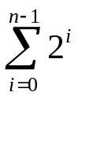
Growth-Rate Functions – Hanoi Towers (cont.)
There are many methods to solve recurrence equations, but we will use a simple method known as repeated substitutions.
T(n) = 2*T(n-1) + c T(n-1)= 2*T(n-2)+c
= 2 * (2*T(n-2)+c) + c
= 2²*T(n-2)+2c+c T(n-2)= 2*T(n-3)+c
= 2²*(2*T(n-3)+c )+2¹c+2⁰c
= 2³ * T(n-3) + (2²+2¹+2⁰)*c (assuming n>2)
when substitution repeated k-1th times
= 2^{k} * T(n-k) + (2^{k-1}+ ... +2¹+2⁰)*c
When k=n
= 2^{n} * T(0) + (2^{n-1}+ ... +2¹+2⁰)*c
= 2^{n} * c1 + ( )*c
= 2^{n} * c1 + ( 2^{n}-1 )*c = 2^{n}*(c1+c) – c ➔ So, the growth rate function is O(2^{n})

Slide 43
What to Analyze
An algorithm can require different times to solve different problems of the same size.
  Eg. Searching an item in a list of n elements using sequential search. ➔ Cost: 1,2,...,n
Worst-Case Analysis –The maximum amount of time that an algorithm require to solve a problem of size n.
  This gives an upper bound for the time complexity of an algorithm.
  Normally, we try to find worst-case behavior of an algorithm.
Best-Case Analysis –The minimum amount of time that an algorithm require to solve a problem of size n.
  The best case behavior of an algorithm is NOT so useful.
Average-Case Analysis –The average amount of time that an algorithm require to solve a problem of size n.
  Sometimes, it is difficult to find the average-case behavior of an algorithm.
  We have to look at all possible data organizations of a given size n, and their distribution probabilities of these organizations.
  Worst-case analysis is more common than average-case analysis.

Slide 44
What is Important?
An array-based list retrieve operation is O(1), a linked-list-based list retrieve operation is O(n).
But insert and delete operations are much easier on a linked-list-based list implementation.
➔ When selecting the implementation of an Abstract Data Type (ADT), we have to consider how frequently particular ADT operations occur in a given application.
If the problem size is always small, we can probably ignore the algorithm’s efficiency.
  In this case, we should choose the simplest algorithm.

Slide 45
What is Important? (cont.)
We have to weigh the trade-offs between an algorithm’s time requirement and its memory requirements.
We have to compare algorithms for both style and efficiency.
  The analysis should focus on gross differences in efficiency and not reward coding tricks that save small amount of time.
  That is, there is no need for coding tricks if the gain is not too much.
  Easily understandable program is also important.
Order-of-magnitude analysis focuses on large problems.

